Slide 1

Analyzing COVID-19 Trends
PORTFOLIO
Design Agency Name
#
GROUP 13
Hiya Bhandari, Sanchari Hazra, Stephanie Lee, Kotomi Sato
GROUP 13
Notes:
Our names
Today, we are here to analyze Covid-19, and study its impact on global health by examining population trends.

Slide 2

Introduction
We performed an examination of particular aspects of the COVID-19 pandemic
CASE COUNTS
ASSOCIATED
CONDITIONS
VACCINATION RATES
DEATH COUNTS
Notes:
Our main discussion today is to go over epidemiological perspectives of the pandemic including cases, deaths, associated risk factors, and vaccination status.

Slide 3
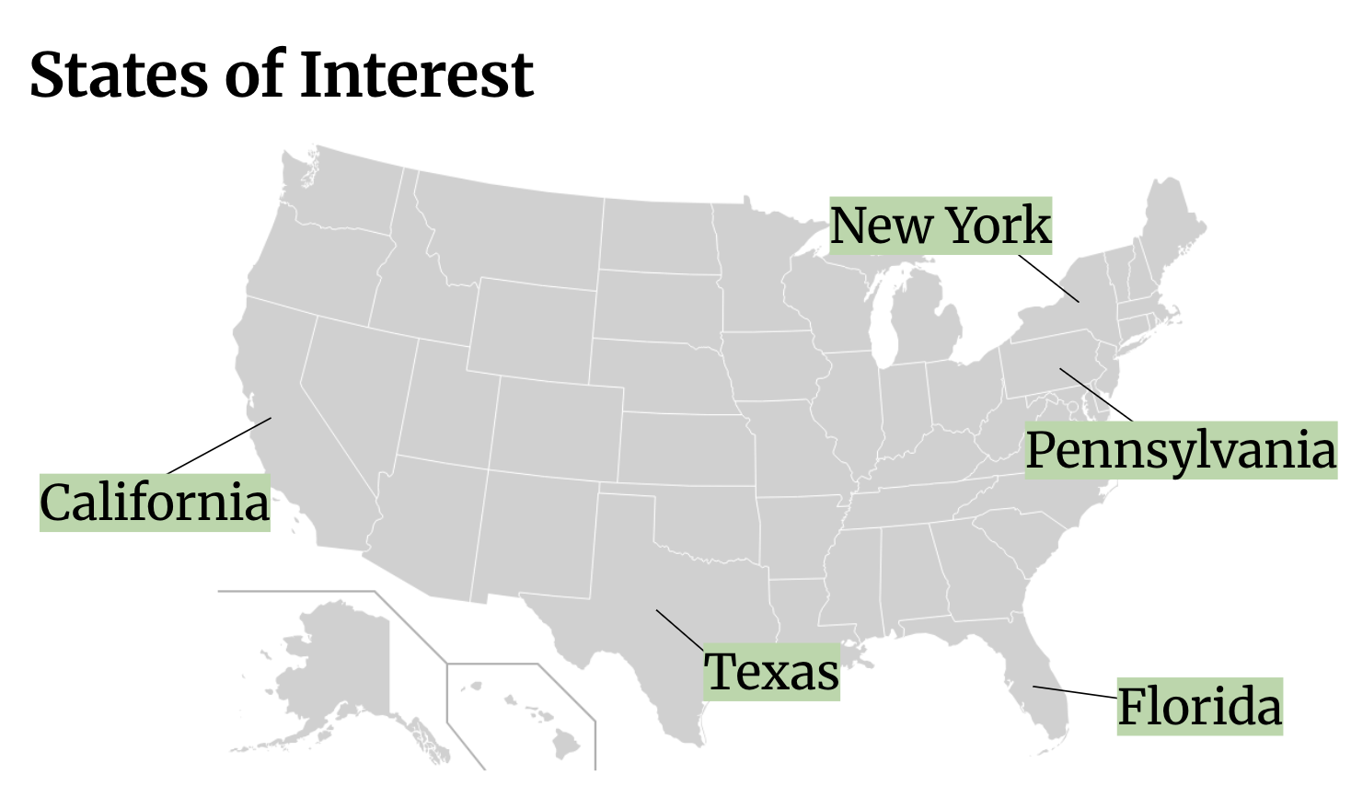


Methods
Three government datasets from the Centers for Disease Control and Prevention and Department of Health and Human Services
Cleaning state names (ex. NY+NYC)
Use of lubridate package to prepare data for time-based plots
Notes:
We gathered three datasets from the CDC and Department of Health and Human Services. And we filtered out 5 states as our main focus points. Some of the problems we encountered were unorganized state names that needed to be combined into a single variable. We also needed to clean dates to use it on a time-based plot.

Slide 4
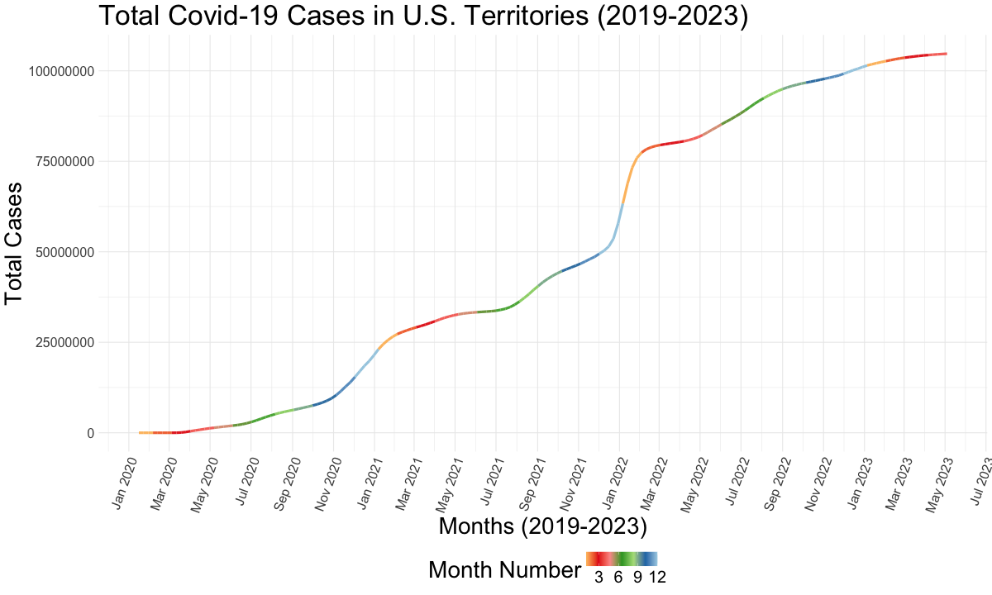
Passed 100 million cases
First U.S. Case, Reported on Jan 20, 2020
Notes:
This is a visual of the number of total cases of Covid-19 in all U.S. territories. The first case was reported on January 20, 2020, and since then to 2023, the pandemic has totaled over 100 million cases.

Slide 5
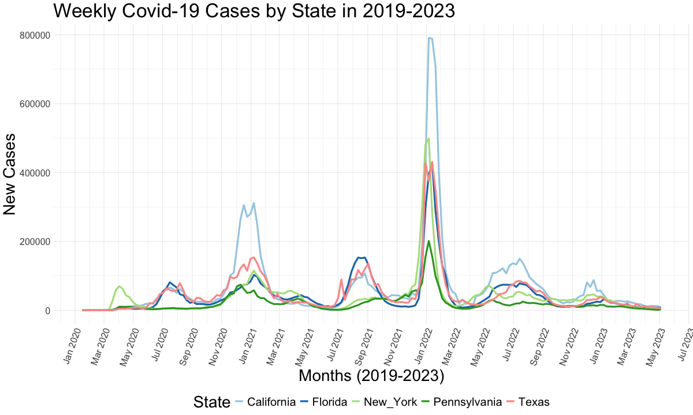
Notes:
Here in this graph, I modeled incidence of covid-19 cases by month. California had the highest peaks, mainly due to its population size. The winter months had a drastic increase of cases while the summer months had smaller milder peaks. An interesting thing to note, is that New York began to record cases in March 2020, but also happened to peak in cases simultaneously. On the other hand, Pennsylvania had a slow start and peaked later in Nov 2020.

Slide 6
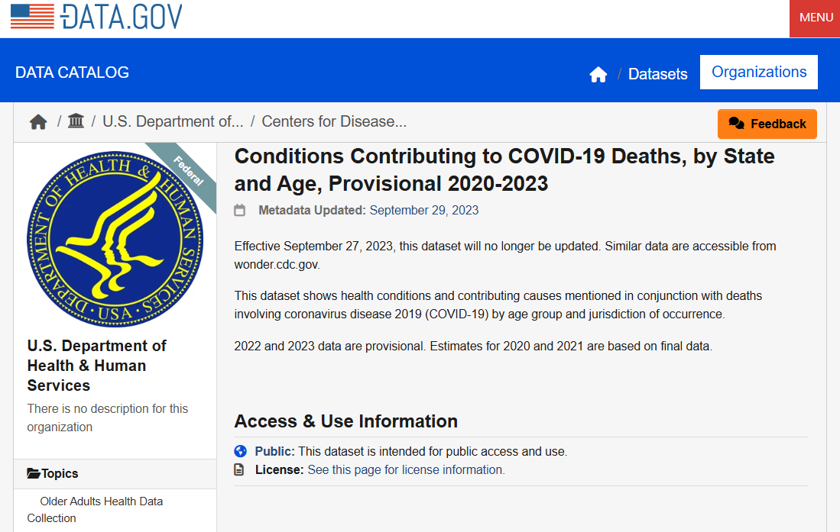
The data
Government data– USDHHS
“This dataset shows health conditions and contributing causes mentioned in conjunction with deaths involving coronavirus disease 2019 (COVID-19) by age group and jurisdiction of occurrence.”
Deaths reported by month, from 2020-2023
from data.gov

Slide 7


The conditions
Respiratory diseases
Influenza and pneumonia
Chronic lower respiratory diseases
Adult respiratory distress syndrome
Respiratory failure
Respiratory arrest
Other diseases of the respiratory system
Circulatory diseases
Hypertensive diseases
Ischemic heart disease
Cardiac arrest
Cardiac arrhythmia
Heart failure
Cerebrovascular diseases
Other diseases of the circulatory system
COVID-19: indicated in cases where no additional disease was mentioned in conjunction with death
Sepsis
Malignant neoplasms
Diabetes
Obesity
Alzheimer disease
Vascular and unspecified dementia
Renal failure
Intentional and unintentional injury, poisoning, and other adverse events
All other conditions and causes (residual)
Notes:
<a href="https://www.flaticon.com/free-icons/lungs" title="lungs icons">Lungs icons created by Mayor Icons - Flaticon</a>
<a href="https://www.flaticon.com/free-icons/healthcare-and-medical" title="healthcare and medical icons">Healthcare and medical icons created by freeer - Flaticon</a>

Slide 8
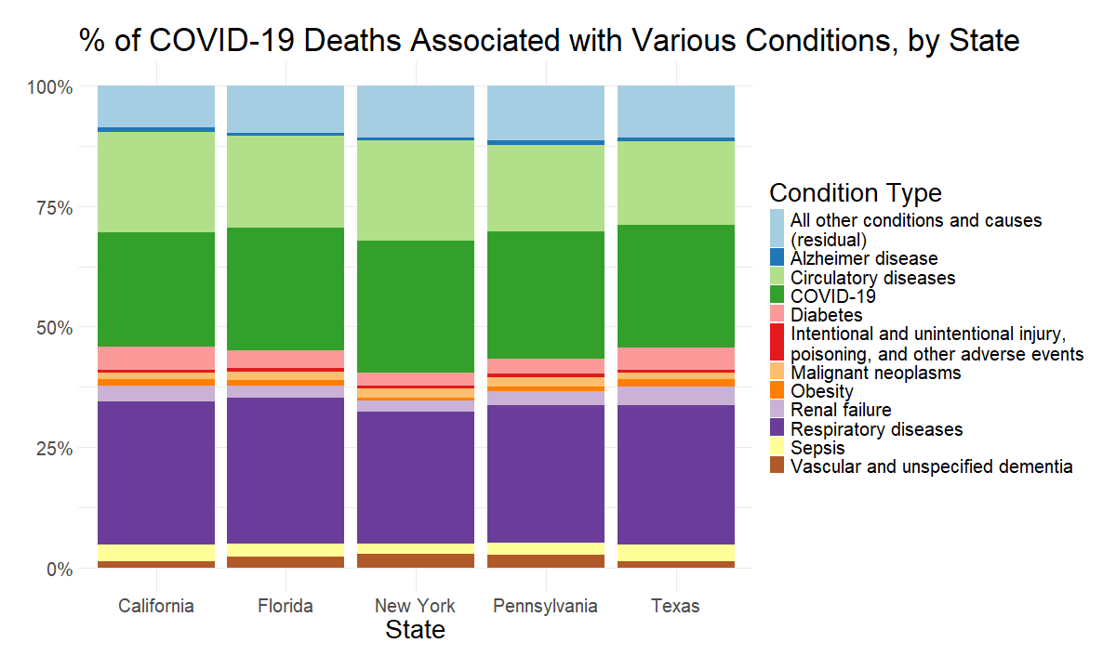
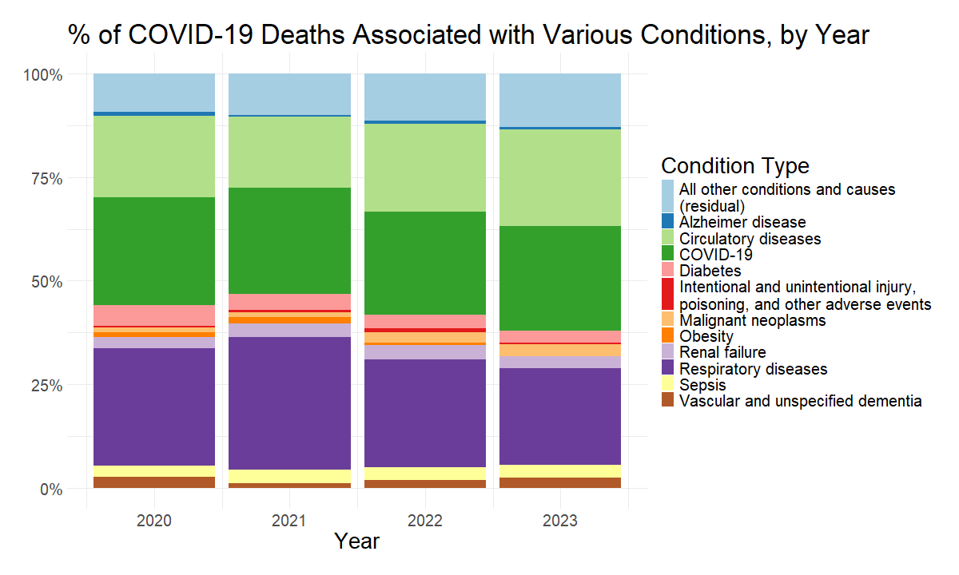
Larger proportion of respiratory-disease associated deaths in 2021
Totaled across three years of recorded data (2020-2023)
Consistent composition across states
Respiratory and circulatory disease are dominant non-COVID-19 contributors to mortality

Slide 9
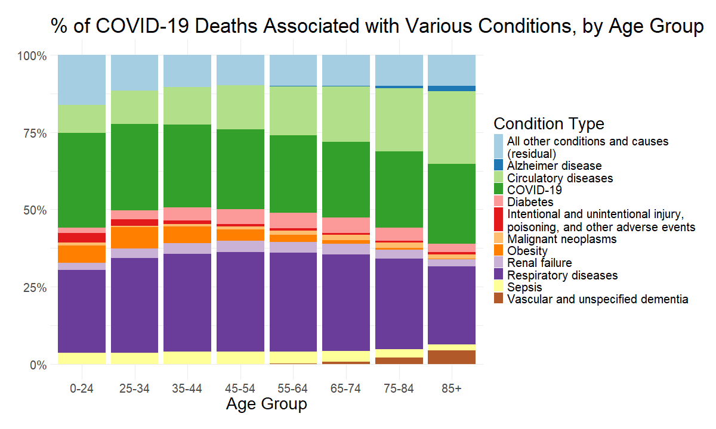
Trends observed over age group
Trends generally align with expectations:
prevalence of circulatory disease association increases with age; same with Alzheimer’s and dementia
obesity-associated deaths less prevalent in older age groups

Slide 10
Shiny App

Slide 11
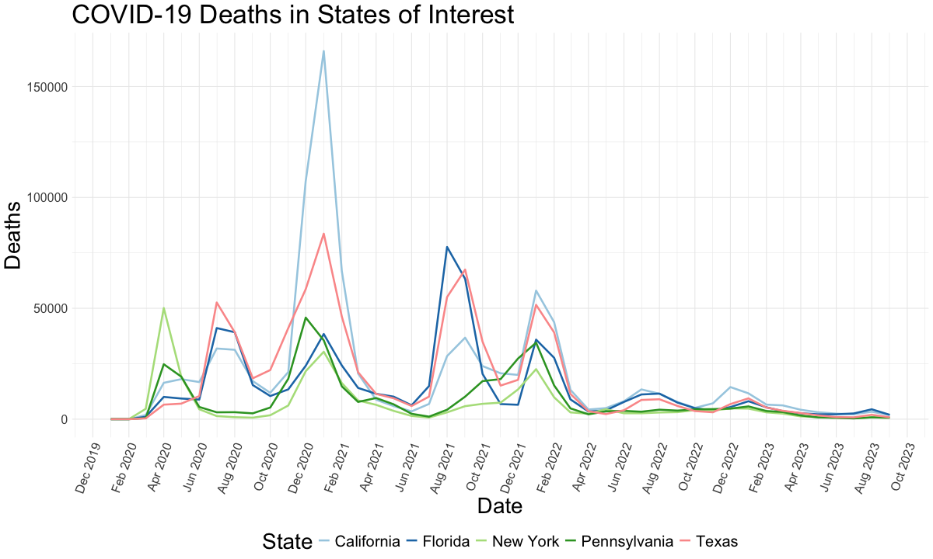
Reasons for Increased COVID-19 Deaths from Dec - Feb
Holiday Events
Weakened Immunity
Healthcare Strain
Notes:
COVID-19 deaths often increase from December to February due to several factors. Holiday gatherings during Thanksgiving, Christmas, and New Year's lead to an increase in the spread of the virus. Winter also weakens immune systems, and hospitals face higher patient loads, reducing resources. Delayed reporting during holidays may also contribute to a spike in reported deaths.

Slide 12
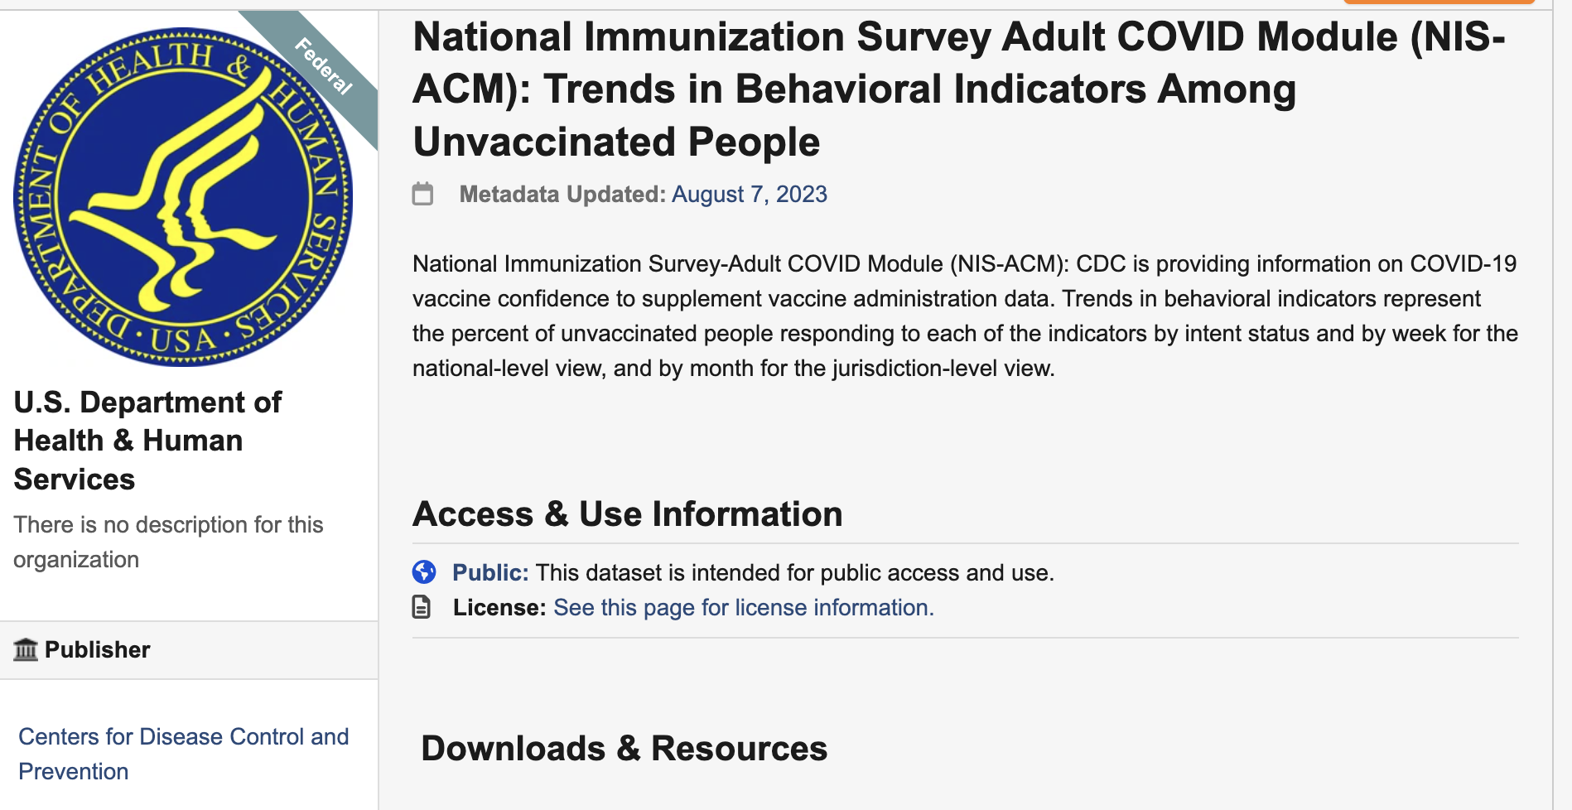
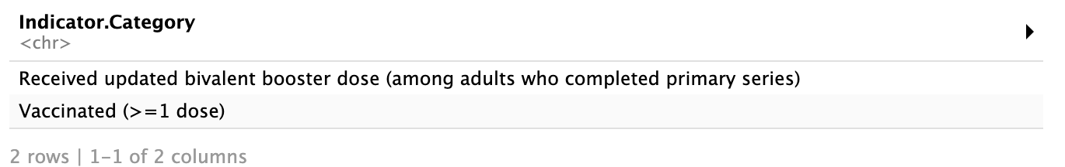
The data
Government data: U.S department of Health and Human services.
The dataset primarily tracks the behaviors of unvaccinated individuals but also includes data on those who have been vaccinated or/and received the booster dose.
In my analysis, I focused on two categories:
Those who have received at least one dose
Those who have received the bivalent booster dose
Data.gov

Slide 13

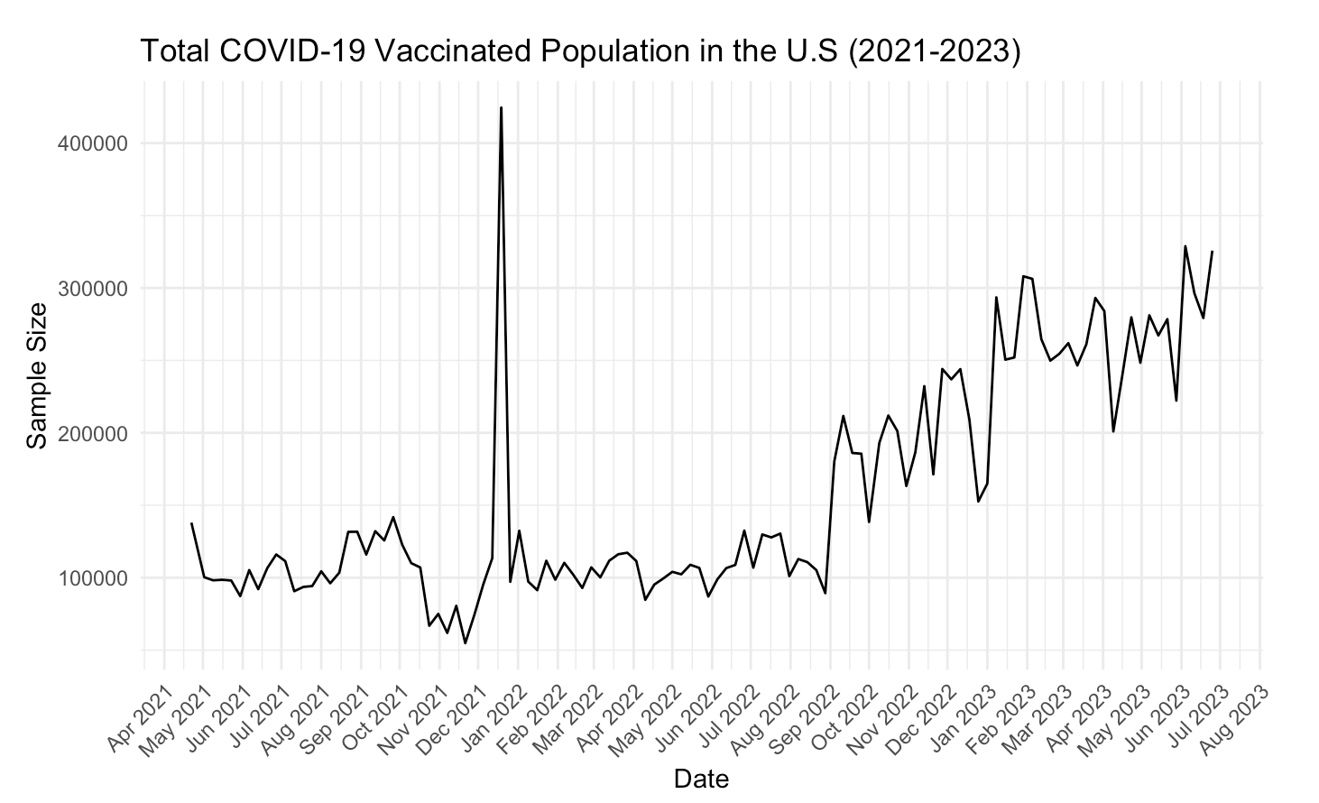
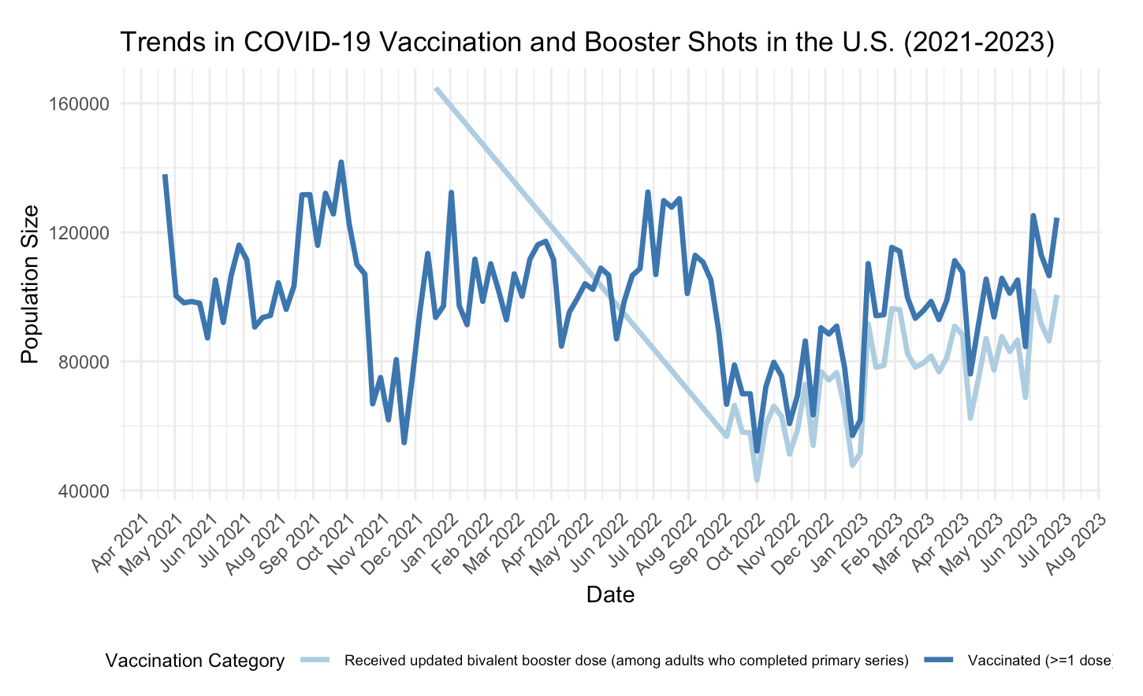
TRENDS IN COVID-19 VACCINATION ACROSS THE U.S
In the United States, 81% of the population has received at least one dose, and 70% is considered fully vaccinated. Of those, 30% has received a booster dose.
WHY THE PEAK?
FDA authorized COVID-19 booster shots for all individuals 18 years of age and older in November 2021.
Notes:
https://www.cdph.ca.gov/Programs/CID/DCDC/Pages/COVID-19/Vaccine-Booster-QA.aspx
We see a increase in vaccinated individuals towards the end of 2021 because FDA authorized COVID booster shots for all individuals 18 years of age and older

Slide 14
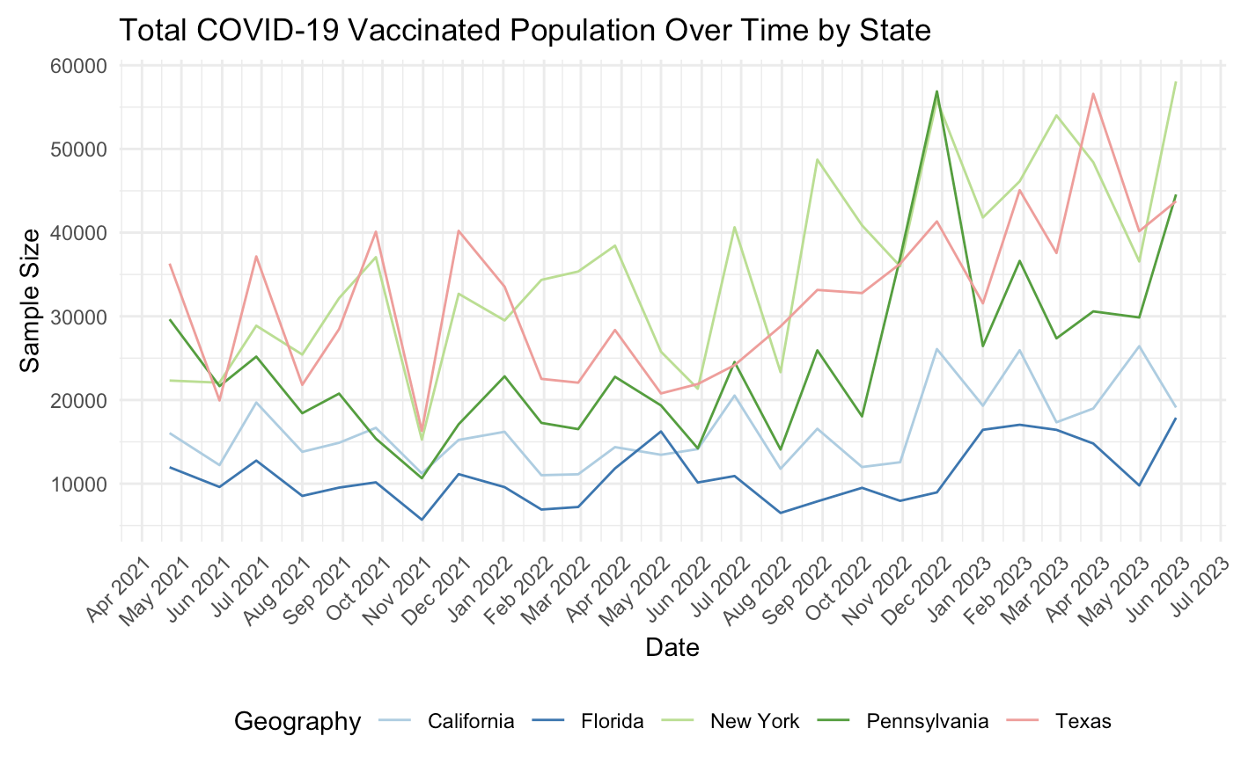
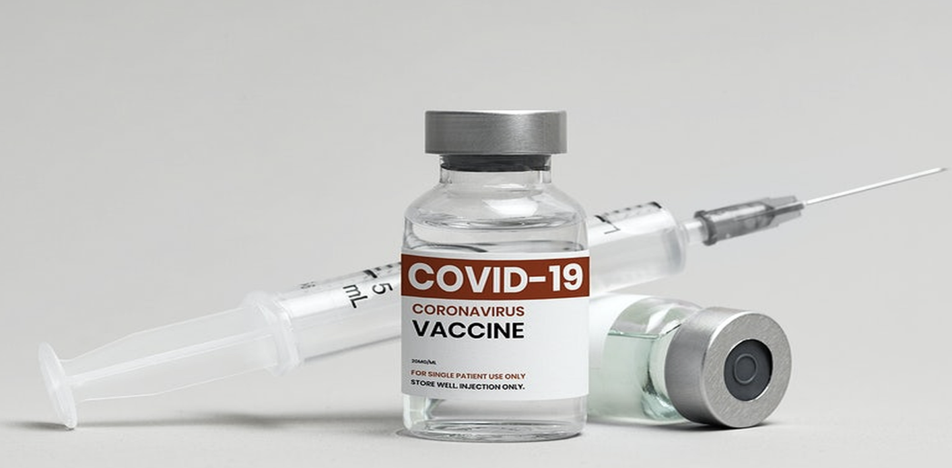
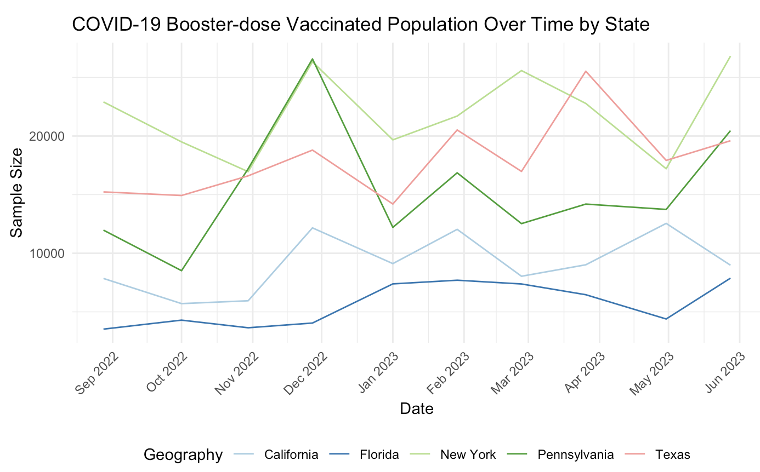
VACCINATION TRENDS BY STATES:
Over 90% of NY residents were vaccinated with at least one dose. And over 82% of NY residents received the two-dose primary series.
In Texas, 77% of the state’s population received at least one dose. A possible reason for the higher vaccination trend is that Texas has the highest number of counties in the U.S.
85% of California state has received at least one dose. And 75% of California's population are considered fully vaccinated.
Florida's low COVID-19 vaccination rates was significantly associated with voting preferences in the 2020 presidential election.
Overall, the trends align with our expectations:
A higher prevalence of vaccinated individuals leads to a reduced number of deaths in the population across all states.
Notes:
In California, 33,613,401 people or 85% of the state has received at least one dose.
Overall, 29,588,939 people or 75% of California's population are considered fully vaccinated.
Additionally, people or <1% of California's population have recieved a booster dose

Slide 15
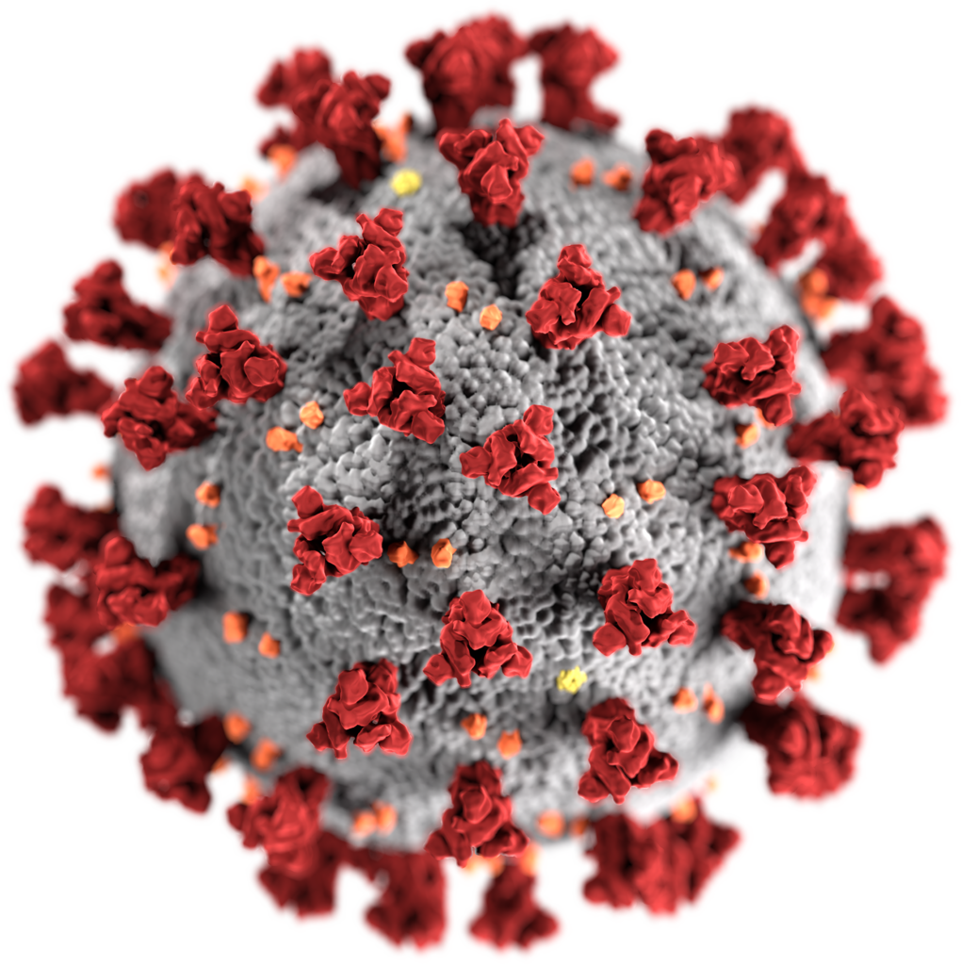
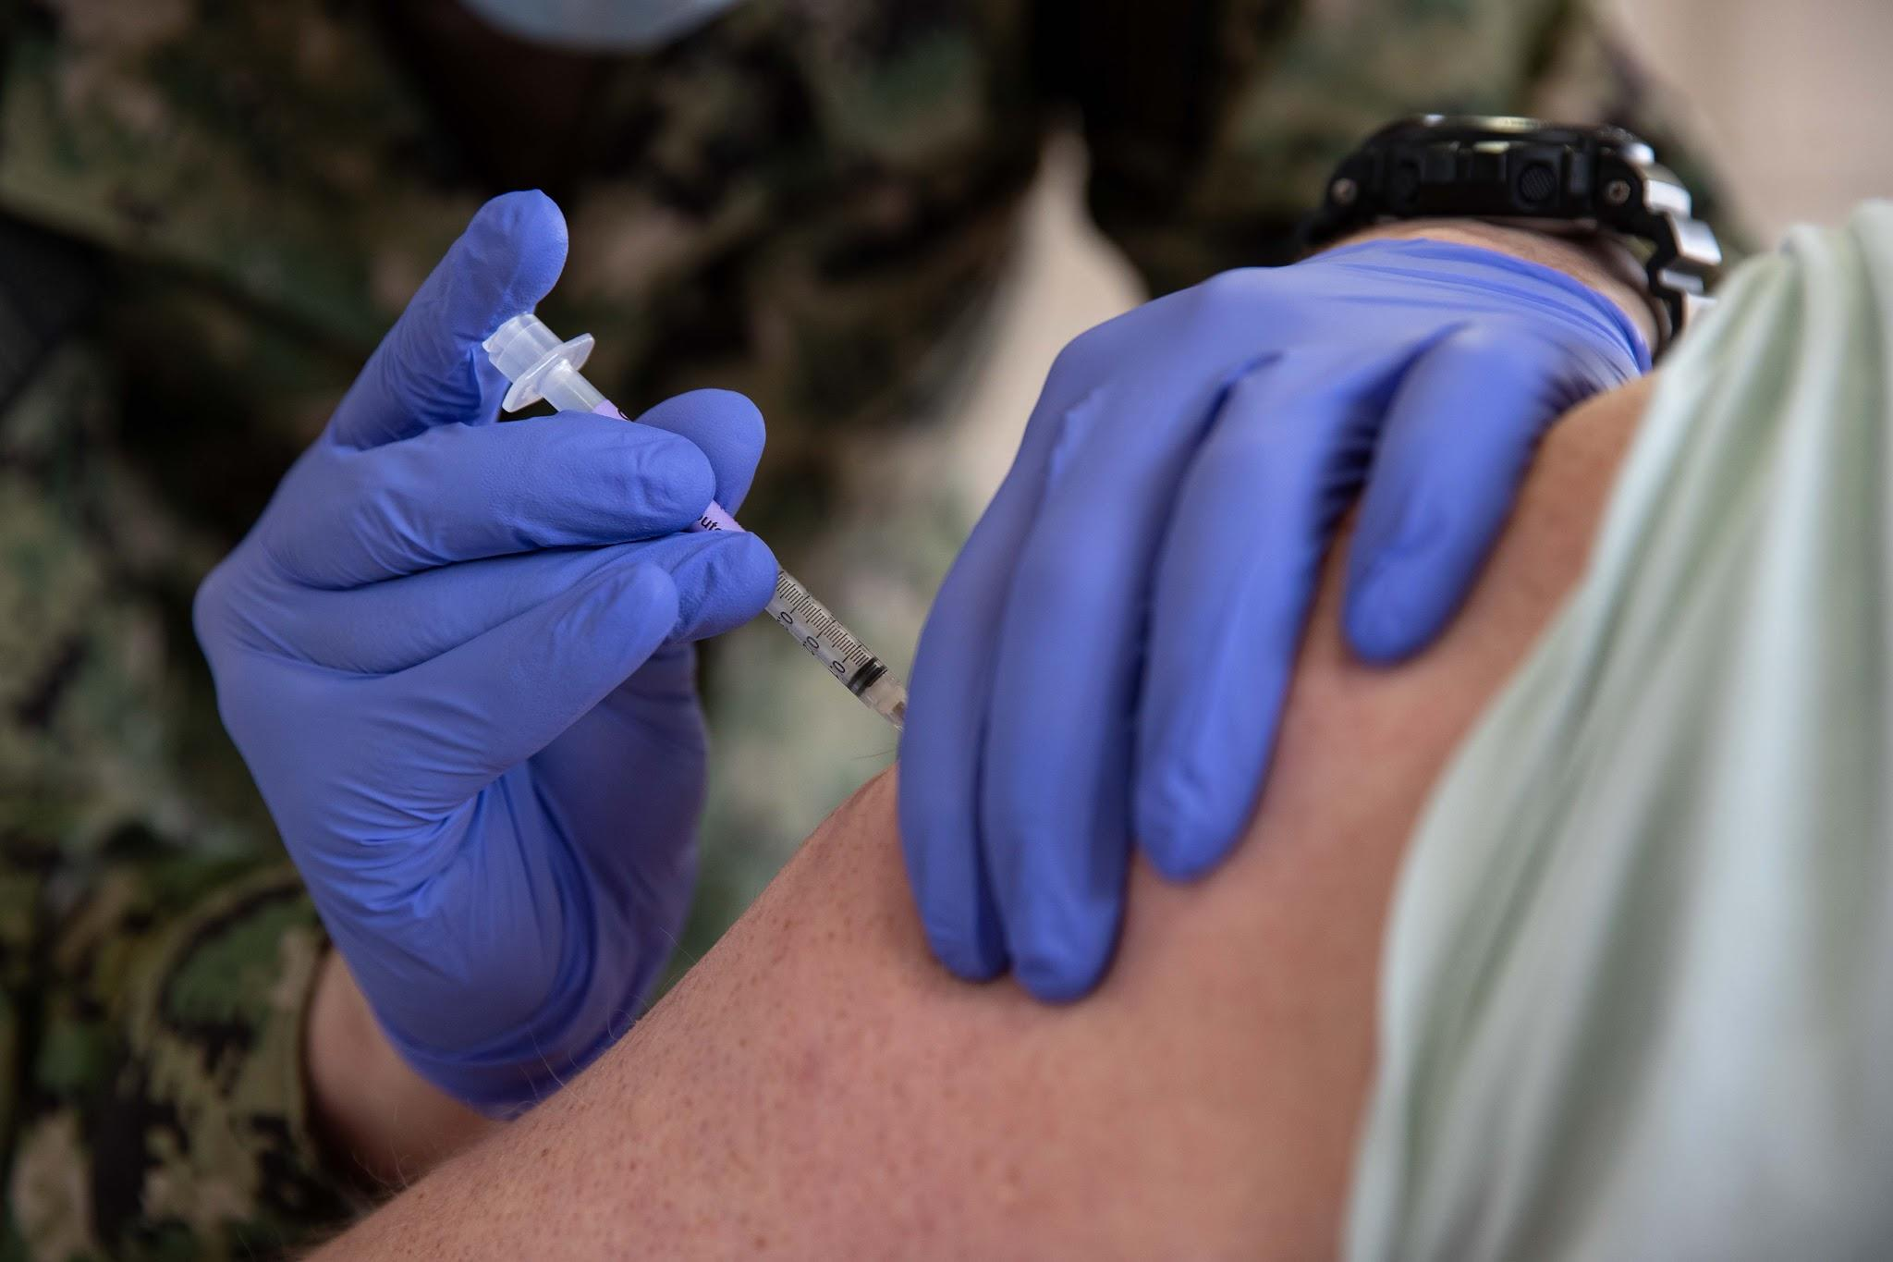
Conclusions
Examined trends in COVID-19 cases, deaths, and vaccinations from 2020-2023
Explored trends in comorbidities and mortality in the COVID-19 pandemic
Higher vaccination rates ultimately contribute to a decline in death count!

Slide 16

Thank You!

